Slide 1

Hospital Management System
By Ambarkar Supriya

Slide 2
Objective of the project: To perform CRUD Operations on Hospital Management System. These include: 1. Efficient Data Management 2. Optimized Performance 3. Secure Data Handling

Slide 3
Introduction: -> Hospital Management System is a system enabling hospital to manage information and data related to all aspects of healthcare – Doctors, Patients, Tests, Appointments. -> Hospital Management System translates to being able to track patient history, provide better care, keep track of appointments, save patient data and tests data, enable doctors to check patient history.

Slide 4
Entities:
Doctor
Patient
1. In patient (IP)
2. Outpatient (OP)
3. Appointment
4. Tests

Slide 5
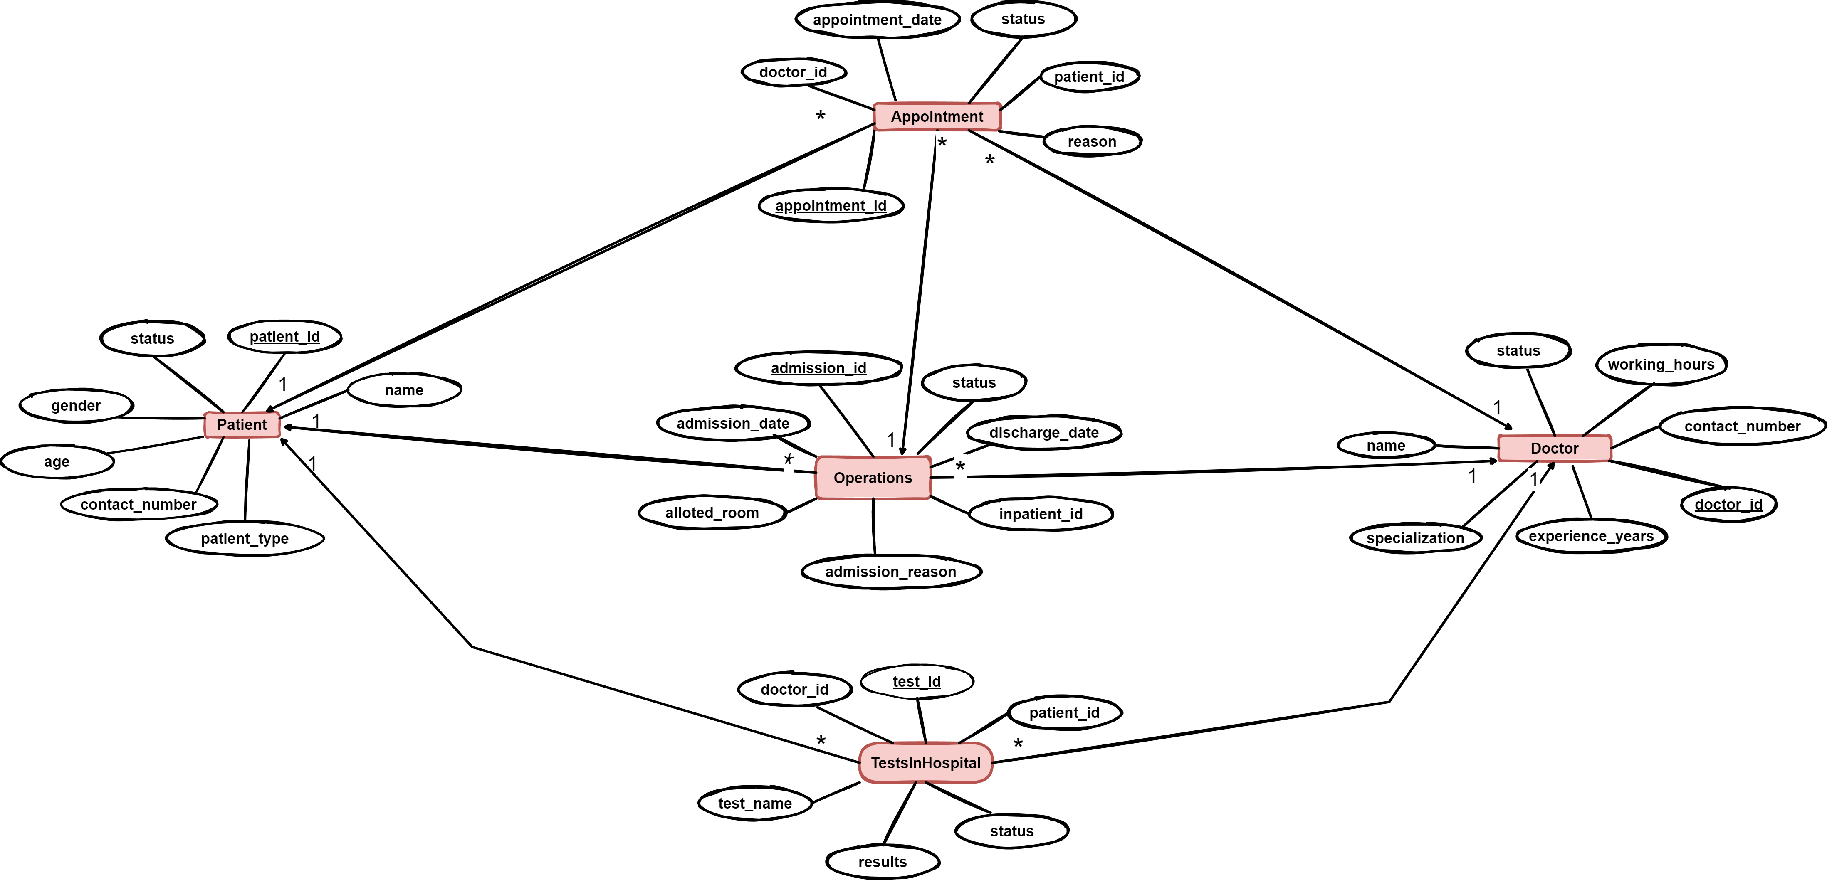

Slide 6
Attributes of Hospital Management System:
2. Appointment
appointment_id
appointmentDate
reason
status
doctor_id (fk)
patient_id (fk)
Doctor
doctor_id
name
working_hours
specialization
contact_no
experience_yrs
status

Slide 7
3. Out Patient
patient_id
name
gender
age
contact_no
status
doctor_id (fk)
4. In Patient
admission_id
admissionDate
alloted_room
admission_reason
discharge_date
patient_id (fk)
status

Slide 8
5. Tests
test_id
testName
results
status;
patient_id (fk)
doctorId (fk)

Slide 9
Technologies Used :
Language used : Java
Framework : Hibernate
Database : SQL (MySQL)

Slide 10
Thank You

